Slide 1
SOFTWARE
REQUIREMENTS
Fundamentals  Object-Oriented (OO) Analysis
- Overview - Basic Concepts
- Analysis Principles - OO Analysis Modeling
Structured Analysis - OO Data Modeling
- Notation
- Extensions for Real Time
- Mechanics
- Requirements Dictionary
Notes:
Objectives of Module 4
Present and discuss the basic concepts of Software Requirements Analysis:
Structured Analysis
Object-Oriented Analysis

Slide 2
Software Development
Lifecycle
System
Engineering
Analysis
Design
Coding
Testing
Maintenance

Slide 3
Status Quo
No defined requirements analysis process.
Models, methodology and tools used for s/w design and development, but not for requirements engineering.
Importance of the requirements often overlooked until too late.
Requirements not maintained throughout the lifecycle.
Often written as an afterthought (usually because here was a contractual obligation to write a requirements document).

Slide 4
Definition of Requirements
requirements are what the system must do
logical vs. physical
essential vs. implementation
problem vs. solution
NOT a statement of how the system will do it
NOT a statement of why the system will do it

Slide 5
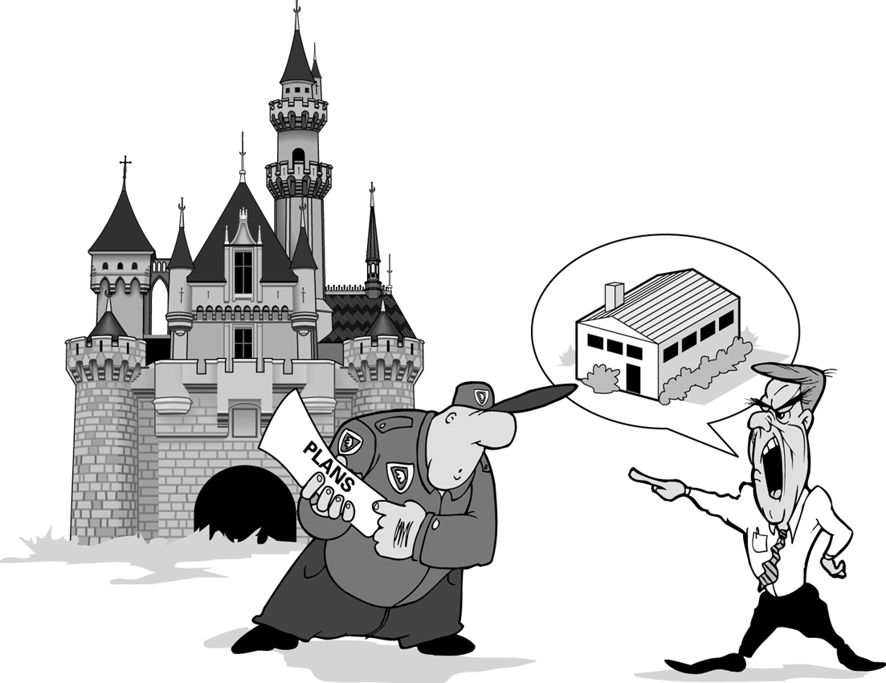
Purpose of Requirements Analysis?/1

Slide 6
Purpose of Requirements Analysis?/2
To achieve agreement on what is to be produced.
To decrease ambiguity and increase consistency and completeness.
To do this, understand the customer need.
  If you do not understand what the customer wants you will fail
  Seek first to understand and then to be understood [Covey]
To document the agreed set of requirements.
  It is not enough just to understand what the customer wants, it is also necessary to record that understanding
SHARED VISION

Slide 7
Purpose of Requirements Analysis?/3
To identify key issues: requirements with strong influence on cost, schedule, functionality, risk or performance
To provide a basis for system design
To provide a reference point for system validation
What if there are problems in the customer provided system specification?
COMMUNICATION

Slide 8
Kinds of Requirements
functional (capability) requirements
timing (performance) requirements
data requirements
external interface requirements
user (human engineering) requirements
quality requirements (reliability, expandability, etc.)
design constraints
adaptation requirements
procedural requirements

Slide 9
Motivation For Specifying Requirements
to eliminate vagueness and ambiguity
to establish feasibility
to scope the task
to form a contract with the customer
to provide guidance to the developers

Slide 10
Basic Activities of
Software Requirements Analysis
Define the functional domain - functions are to be performed?
Define the information domain - flow of information in the system, structure of that information, and content of that information?
Partition the problem - hierarchy of the problem?
Develop the logical view of the requirements - detail the functions and data
Develop the physical view of the requirements - detail the real-world forms of the functions and data

Slide 11
Common Problems During Requirements Analysis
General communications problems
  not understanding the problem
  misinterpreting information
  missing information
Acquiring pertinent information
Handling problem complexity
Accommodating changes during and after analysis

Slide 12
The Benefits of Good Requirements
Agreement among engineers, customers and users on the job to be done and the acceptance criteria of the delivered system
A sound basis for resource estimation
Improved system effectiveness factors
  What if the customer doesn’t specify these?
The achievement of goals with minimum resources (less rework, fewer omissions and misunderstandings)
Reduced “expectation gap”

Slide 13
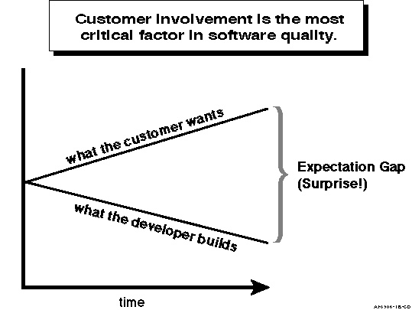
Expectation Gap

Slide 14
The Problems with Bad Requirements
Creeping user requirements
Unplanned requirements changes degrades quality
Ambiguous requirements lead to ill spent time
Increases expectation gap
  Customer and engineer have different interpretations
  needs of user classes overlooked
Fuzzy requirements make planning very difficult
The product may not be fit for use
Can lead to cost and schedule overruns

Slide 15
Why don’t we write good requirements?
They are difficult to write: sophisticated problem solving is required to produce a good statement of requirements
It is next to impossible to capture user needs completely
Desire to truncate the activity and “progress” to the next activity: schedule pressure.
Customers failure to cooperate in effectively verifying that the requirements are correct
Assumptions are made which are not documented or discussed
“How” instead of “What” is written
Engineers lack of training in requirements engineering
We don’t pay attention to lessons learned.

Slide 16
Why Johnny can’t write requirements/1
[Hooks]
He doesn’t know what to do
  School encourages poetic, entertaining prose
  He doesn’t understand the process
  Training and examples needed
He doesn’t understand why he should do it
  He doesn’t understand the impact
  “It’s just documentation”

Slide 17
Why Johnny can’t write requirements/2
He would rather be doing something else
  He would rather be doing design
  He doesn’t have enough time to do a good job
  He believes the review process will catch his errors
He sees no reward
  Really only verified when system working
  No reward for doing a good job

Slide 18
When is it performed?
Waterfall
  Requirements definition for whole system completed prior to system design
Incremental Development
  Detailed requirements definition for each increment performed prior to that build
  Feedback from users may affect requirements for later increments.
Spiral
  Performed each loop round the spiral
Notes:
The primary source of difficulty with the waterfall model is it’s emphasis on fully elaborated documents as completion criteria before proceeding onto subsequent phases.
Incremental development is for a series of development efforts, each of which leads to a delivered product to be used in an operational environment - each delivered increment adds some needed operational capability.

Slide 19
Part 2:The Requirements Definition Process
Requirements Elaboration
Requirements Analysis
Requirements Representation
Requirements Communication and Negotiation
Preparation for System Acceptance

Slide 20
Requirements Elaboration
Initial requirements often need elaboration
Requirements elicitation and elaboration sources:
  Operational Concepts and Scenarios
  System Specifications
  Interviews/questionnaires
  Observation of the operational environment
  Use cases
  Project Champion
  Prototyping poorly understood requirements
Notes:
Initial identification and acquisition of requirements performed in System Concept Definition, so in this phase it should just be elaboration of requirements.
It really involves fact-finding, gathering data and information from various sources, understanding the information gathered and communicating open issues for resolution.

Slide 21
Requirements Analysis
Synthesize data gathered during elaboration:
Apply analysis techniques
Assessment of potential problems
  ambiguity, incompleteness, inconsistency
Classification of requirements
  mandatory, desirable, non-essential: prioritize mandatory requirements
  identify global requirements
  determine volatity
Evaluation of feasibility and risks
  technical, operational, economic
Notes:
This is the analysis of the data gathered from the various sources in the previous phase.
Steps are iterated until all problems are solved.
Mandatory, desirable and non-essential: also Must, Should and Could.
Indication of stability will allow decisions on when to build that requirement, and if unstable, design so that potential impacts of change are isolated.

Slide 22
Requirements Representation
Portrayal of results of requirements definition: how do we represent the requirements for communication to the stake holders?
  Use of models - do analysis models belong in the requirements document?
  Prototyping?
  Textual vs graphical?
  Multiple views reduces expectation gap
Notes:
This is the stage of requirements definition when the results of requirements elaboration and identification are documented or portrayed
Models used to portray the results of requirements elicitation and to facilitate the requirements analysis process.
Prototypes often used to provide early feedback to customers and end-users and to improve communication of requirements between users and system engineers.
The final requirements have to be testable. MDA proposes that only the textual requirements form the contractual baseline. Example in structured analysis, the text in the p-specs is testable, but the interfaces in the DFDs are not.

Slide 23
Requirements Communication and Negotiation
Results of the requirements definition presented to stakeholders for review and approval
Negotiate and resolve conflicts, omissions, inconsistencies, risks with stakeholders
Usually results in more iterations through the requirements definition process to obtain agreement

Slide 24
Preparation for System Acceptance
Need to propose acceptance criteria for validation that the delivered system meets the requirements
Need to propose acceptance techniques
Need to get agreement with the customer
Notes:
Validation techniques: Analysis, Inspection, Test, Demonstration.
Validation: Proving to the customer that we met the stated requirements. Did we build the right system?
Verification: Did we build the system right?

Slide 25
Part 3: The Products of Requirements Engineering
Characteristics of High Quality Requirements
Types of Requirements
Conflicting Types of Requirements
Requirements Documents Standards

Slide 26
Characteristics of High Quality Requirements/1
Necessary
Unambiguous
Complete
Consistent
Concise
Correct
Verifiable
Maintainable
Feasible
Implementation free
Traceable
Understandable

Slide 27
Ways to Achieve High Quality Requirements/1
Necessary
  Does it trace to a higher level source document?
  Prioritize into essential, desirable, nice to have (from customers viewpoint)
  Consider removing any non-essential requirements
  Remove “gold plating”
  “Optional requirement” is oxymoronic, but there are relative importances of requirements
  Ask “what will happen if I take it out?”

Slide 28
Ways to Achieve High Quality Requirements/2
Unambiguous
  Review with all stake holders: users, customers, developers, testers
  Use multiple models/views
  Walk through operational scenarios and use cases
  Write test cases
  Avoid terms like: minimize, maximize, rapid, quick, fast, user friendly, easy, difficult, sufficient, adequate, appropriate, may, at least, process, flexible, fault tolerant, and/or, etc., accommodate, support, typically, often, accurately, but not limited to.
  Use a project champion
  Use a glossary to define terms
  Use standard constructs, notational conventions, phrases or words (“shall” and “will”)
  Iterate, iterate, iterate.

Slide 29
Ways to Achieve High Quality Requirements/3
Complete
  Do a complete operational concept, if not done already
  Ensure all user classes have been considered
  Ensure all other interfaces have been considered
  Ensure all inputs are used and all outputs are generated
  Walk through operational scenarios
  Breadth vs depth - what is the correct depth?
  Document assumptions
  Accept that in reality it will not be complete. Plan for it!

Slide 30
Ways to Achieve High Quality Requirements/4
Verifiable
  Every requirement must describe some externally observable behavior
  Saying something won’t be done is not verifiable.
  Use measurable quantities, e.g., not “often”, or “quick” (see terms to avoid for ambiguity)
Consistent
  Use glossary so that same term means the same thing everywhere.
  Don’t use synonyms
  Avoid duplication/redundancy
  Analyze to ensure that by meeting one requirement, there is not a conflict with another

Slide 31
Ways to Achieve High Quality Requirements/5
Maintainable
  Avoid duplication
  Use an index or cross reference where necessary
  Avoid unnecessary explanation or detail
Correct
  Ask “Is this what the customer actually needs?”
Implementation Free
  Ask “Is this constraining the solution unnecessarily?”
  Ask “Am I describing a solution, not the problem?”
  Ask “why?”

Slide 32
Ways to Achieve High Quality Requirements/6
Concise
  No unnecessary language or detail.
  Keep phrases and sentences simple. Minimize compound sentences.
  Write a style guide.
Feasible
  Can the requirements be satisfied (technically, cost and schedule) ?
  How close to upper limits are we?
Understandable
  Eschew obfuscation!

Slide 33
The Project Champion
What is a project champion?
  Primary interface between development and customer communities
  Domain expert from the user community
  Reconciles incompatible customer requirements
  Makes decisions on corrections and enhancements
  Provided by the customer

Slide 34
Characteristics of Great Project Champions
Respected member of the user community
Have thorough understanding of application domain
Have suitable level of experience with computer systems
Eagerly anticipate delivery of the product
Have a vision of what the product should be and do
Have support of their management for time commitments
Have lots of energy and patience

Slide 35
How the Project Champion Model can Fail
The champion did not adequately communicate with the user community
  Consensus was never reached on the projects direction
  Champion provided his own narrow perspective of needs
The champion did not have a vision of the product
  Champion provided little useful input
  Many decisions deferred to the analyst
The champion did not feel he had the authority to make decisions, even though he really did.
The Champion failed to serve as an advocate for the system with his peers.

Slide 36
Module Summary
Remember the major role that requirements play in the success or failure of a project
Remember to listen to and understand your customer
Remember the requirements must be analyzed, select from available techniques to assist
Focus on achieving high quality requirements
Don’t allow the use of a tool or technique to make you lose sight of the real problem at hand.

